Slide 1
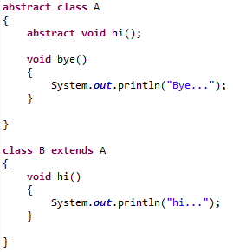
Abstract class in Java
Abstract classes can also have normal methods with definitions, along with abstract methods.
An abstract class must have an abstract method.
Abstract classes can have Constructors, Member variables and Normal methods.
Abstract classes are never instantiated.
When you extend Abstract class with abstract method, you must define the abstract method in the child class, or make the child class abstract.

